Slide 1
Non-Parametric Test: Kruskal Wallis Test (An Alternative to the One Way ANOVA)
Lecture 30-03-2023

Slide 2
Kruskal Wallis Test
When our interest is to test equality of more than two populations mean (i.e. All populations are identical in their means)
In this case we apply Analysis of Variance (ANOVA).
ANOVA has three assumptions that is need to fulfill before applying the ANOVA.
When these assumptions are not fulfilled, then we have two alternative ways
(1) Transformation (2) Non-Parametric Test
Alternate to the ANOVA in Non-parametric Test is Kruskal Wallis Test.

Slide 3
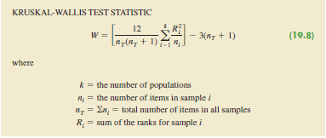
Testing of Hypothesis using K-W Test
Ho: All populations are identical
Ha: Not all populations are identical
Test Statistics is given as

Slide 4
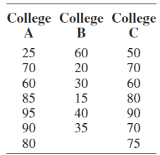
Example Performance evaluation rating of 20 Williams Employees

Slide 5

To compute the W statistics for our sample, we must first rank all 20 data items/ The lowest data value of 15 from college B receive a rank of 1, whereas the highest data value of 95 from the college A sample receives a rank of 20.
We assign the average rank to tied items (for example data value of 60,70,80 and 90 had ties)

Slide 6
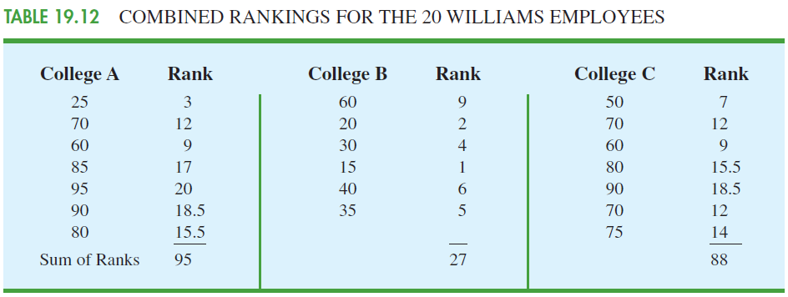
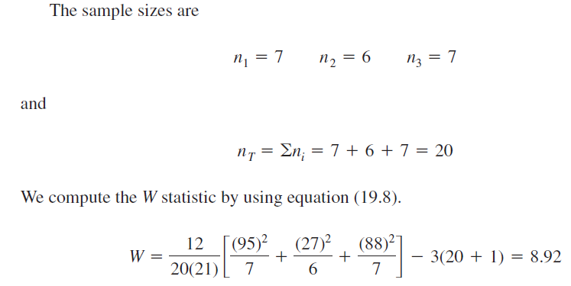

Slide 7
Critical Region
We use Chi-square distribution to determine the critical value for the test.
Reject Ho if W ≥ Χ²_{α(k-1)} K=No. of groups
Since W > Χ²_{0.05(2)}=5.991
So we reject Ho and conclude that Three population means are not equal.

Slide 8
Two-Way ANOVA
When response variable is observed by using two factors, then one way ANOVA is not appropriate. For this purpose we use Two way ANOVA. Which can control variation in two directions.

Slide 9
Two Way ANOVA lay out
 | Treatments
Block | 1 | 2 | 3 | 4 | 5 | 6
1 | 1 | 3 | 6 | 4 | 3 | 2
2 | 1 | 4 | 4 | 8 | 5 | 1
3 | 3 | 6 | 7 | 8 | 4 | 3
4 | 2 | 3 | 2 | 3 | 2 | 1
S.O.V. | Df | SS | MSE | F-ratio
Treatment | k-1
Block | b-1
Error | (b-1)(k-1)
Total | (bk-1)

Slide 10
##--two-way Anova---###
rm(list=ls())
cp=c("1","2","3","4","5","6")
ctp=rep(cp,each=4)
nt=c("nt1","nt2","nt3","nt4")
ntp=rep(nt,6)
y=c(1,1,3,2,3,4,6,3,6,4,7,2,4,8,8,3,3,5,4,2,2,1,3,1)
df=data.frame(ctp,ntp,y)
an=aov(y~ctp+ntp)
summary(an)
mct=TukeyHSD(an,"ctp",0.05)
mct
plot(mct)
res=residuals(an)
qqnorm(res)
plot(res)
ycp=y-res
plot(ycp,res)
pairwise.t.test(y, ctp,.adj="bonf“)

